Slide 1
WEATHER FORECASTING WEB APP
GROUP MEMBERS:-
SAHIL ALI KHAN- 170301200018
SUKANYA MOHANTY- 170301200030
SANKALP MOHANTY- 170301200020
CHINMAYEEMOTI SAHOO- 170301200023

Slide 2
CONTENTS:
What is Weather Forecasting?
Importance of Weather Forecasting
Features of Weather Forecasting
Modules Used
Architecture
System Requirements
Conclusion
Reference

Slide 3
What is Weather Forecasting?
Weather forecasting is the application of science and technology to predict the conditions of the atmosphere for a given location and time.
Weather forecasts are made by collecting quantitative data about the current state of the atmosphere at a given place and using meteorology to project how the atmosphere will change and now a days knowing the weather forecast is very easy as we have a lot of android apps and web apps for it .
Here in this project we have tried to help the people by making a small weather forecast app where we can know the weather condition of any place in the world just by the click of a button.

Slide 4
Displays current weather Condition
Uses python requests to call the OpenWeather App
FEATURES OF WEATHER FORECASTING WEB APP
Cities can be added and deleted
Shows the current temperatutre along with the weather condition of selected cities

Slide 5
Modules used:
python manage.py migrate:- migrate execute those sql commands in the database file so after execution migrate all the tables of your installed apps are created in your database file.
import os:-This module provides information about functions for interacting with the OS .
Models.py:- Django models is the SQL of database on uses with Django.
Tests.py:- Here the unittest module is used . This is covered in details in the writing & running tests document.
Views.py:- A view function is a python function that takes a web request and return a web response.
urls.py:- In this site we store all links of the project and functions to call wsgi.py.
Wsgi.py:- This file used in deploying the project in WSGI. It is used to help your Django application communicate with the server.

Slide 6
MODULES USED:
001-initial.py:- Used for database migration.
Django.urls:- In Django views are python functions which take a URL request as parameter and return an HTTP response.
django.contrib import admin:- For using admin site.
__init__.py:- The --init--.py are required to make python treat the directories as containing packages.
apps.py:- This file is created to help the user include any application configuration for the app.
Forms.py:- basically used for taking input from the user into some manner and using that information for logical informations on database.
Import sys:- This module provides information about constants, functions and methods for the python interpreter.

Slide 7
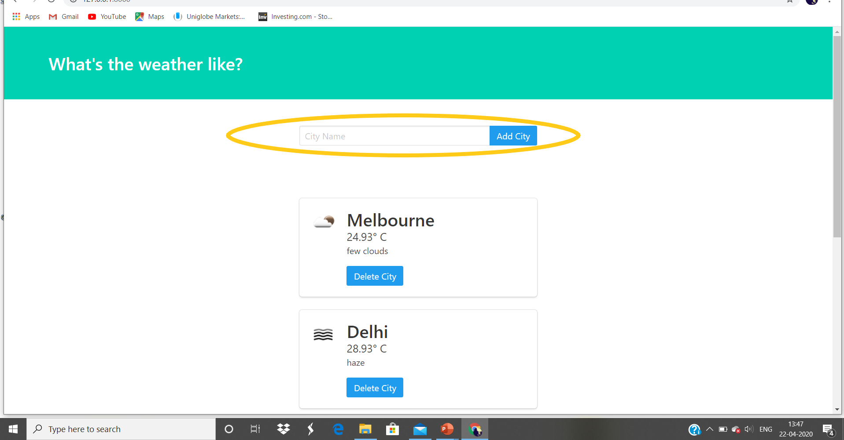
ARCHITECTURE:

Slide 8
ADVANTAGES:
In this app we have to simply put the city name and It will show the output as temperature and the atmosphere condition.
We don’t have to be so knowledgeful about the app we can simply put the city and see the output without latency.
It is very useful because we are using python with Django with the least privileges and it will cost very low for implementation.

Slide 9
SYSTEM REQUIREMENTS:
Windows 2000, Windows XP (32-bit and x64), Windows Server 2003/2008, Windows Vista (32-bit and x64), Windows 7, Windows 8 (32-bit and x64); Windows 10 ,
Windows 2000 or later ,
Internet Explorer 5.0 or later ,monitor : 15” colour ,HDD 40GB
Basic input devices required: keyboard
Basic output devices required: mobile devices
S/W requirement: PyCharm, Python 3.8.0
Technologies used: Advanced programming using Python

Slide 10
REFERENCES:
Openweather.com
Geeksforgeeks.com
Django documentation

Slide 11
THANK YOU

